Slide 1
Compensation Prediction
Team #13
Junyuan Bao
Boyu Chen
Yu Fang

Slide 2
Introduction
Firstly, we decided to predict compensation for accidents using spark machine learning tools and API. (data amount=180k)
Then, we built random forest model, gradient boosting tree model and multilayer perceptron model to solve this problem.
Also , by keep tuning hyper-parameters like number of layers and number of iterations, we get a fair good result on validation test and MAE.
Finally, we compared and evaluated these three different models and made an conclusion about them.

Slide 3
Exploratory Data Analysis
Using spark sql to identify missing data.
Using spark sql to identify data outliers.
Using spark sql to commpute basic data statistics like mean and stdev.
Visulizing data using zeppelin.
Sampling data with dataframe to visualize data points and understand the nature of our data.
Pre-processing dataset and filter invalid data.

Slide 4
Methodology
Using Gradient Boost Tree, Random Forests, multilayer perceptron and other supervised machine learning methods.
Using Spark MLlib decentralized machine learning framework.
Using Spark SQL for EDA.

Slide 5
General Methods
Train-Test Split:
We divide Dataset into two parts, one for training(70%), one for testing(30%).

Slide 6
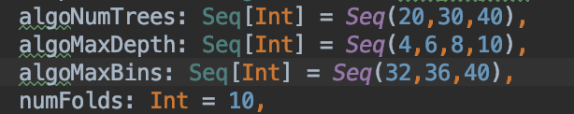
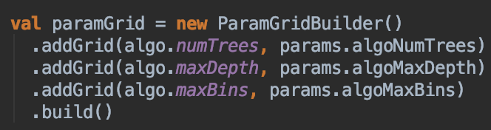
General Methods cont.
Grid Search:
In order to obtain the best model, we need to do this to select the best hyper-parameter combination during training.

Slide 7

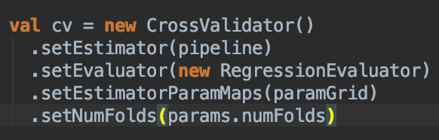
General Methods cont.
K-fold Cross Validation:
Every time we select k-1 of K subsets of input data for training, remain 1 for validation.

Slide 8
Random Forest Solution
Advantages:
when number of features is high and give feature importance.
The speed of this Algorithm is faster among others and it can apply parallelization which correspond to the idea of Spark.
Disadvantage:
It performs not that good when some features have too many types (indexes)

Slide 9
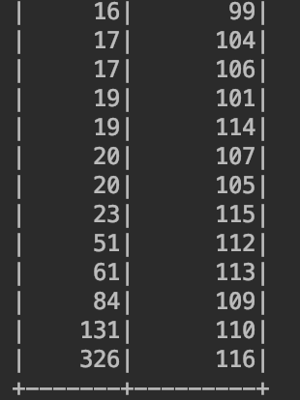
Useful Methods When Apply Random Forest
Data re-format:
In order to apply random forest algorithm, we need to extract feature columns for training and remove columns that have too many feature types.
According to sorting result of features’ type numbers, we will remove bottom five feature columns that has too many feature types.

Slide 10
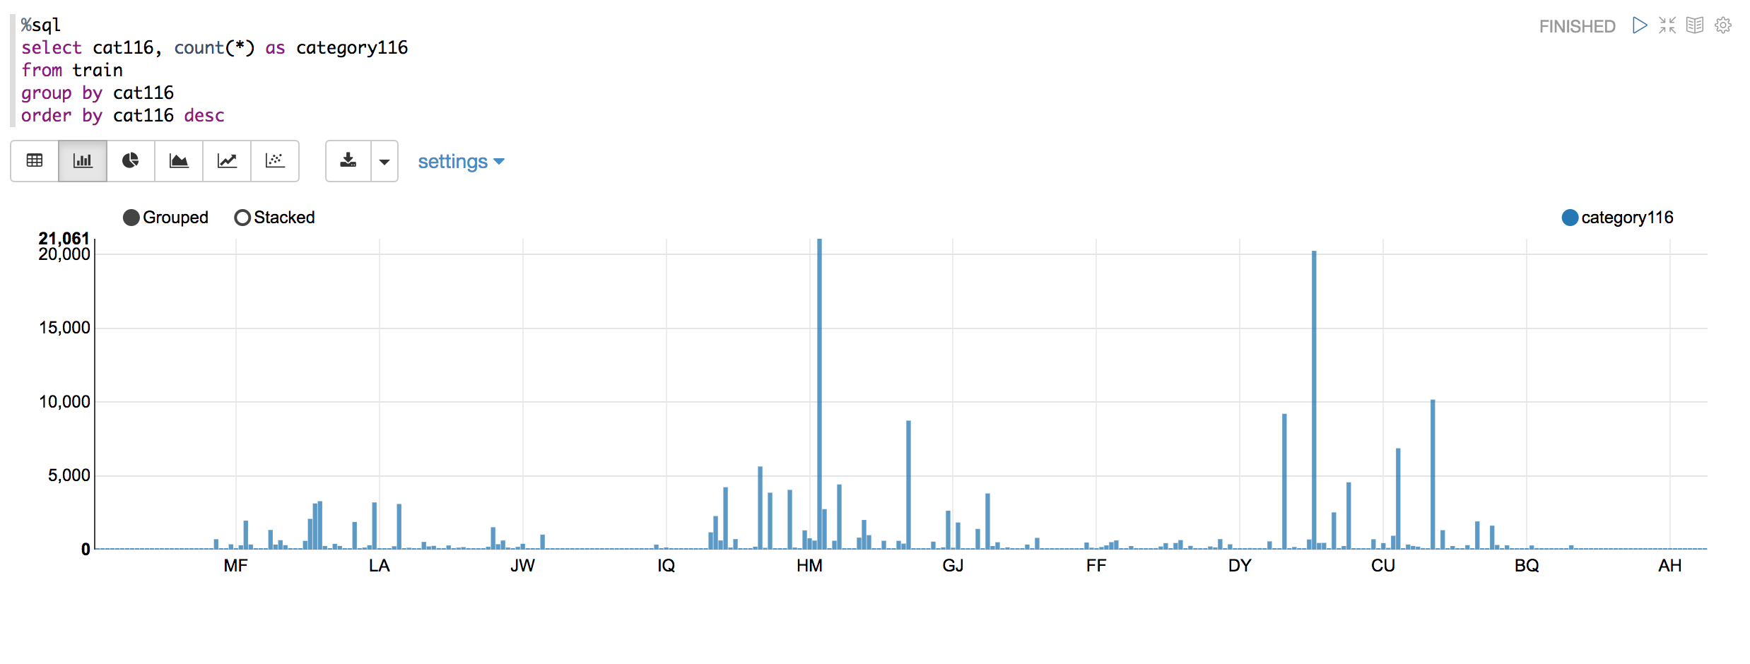
Showing one column with distribution of features

Slide 11
Random Forest Solution cont.
Building Pipline
StringIndexer: Change string type category columns into indieces.
VectorAssembler: Compose feature columns into one feature vector.
RandomForestRegressor: The Random forest model we want to train our data on.

Slide 12
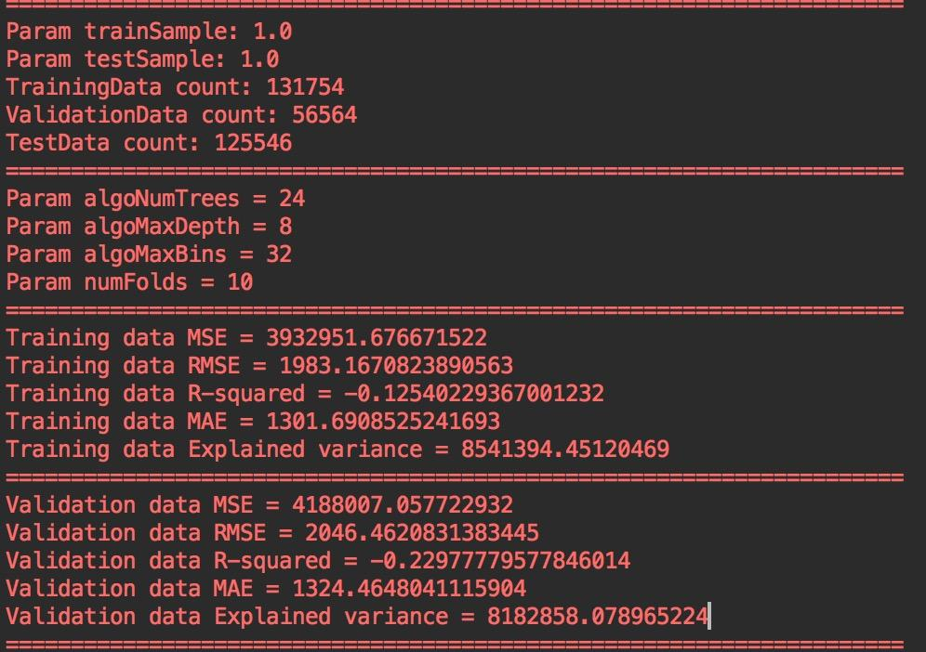
Random Forest Conclusion
MAE is 1324, not that far from the goal 1100, we may still change hyper-parameters.

Slide 13
Multi-Layer Perception Classifier
In addtion to regression, we also tried classification method as MLP.
MLP is a basic neural network model that has input layer, output layer and hidden layer, with activation function that transform model into non-linear form to simulate any non-linear process of data.

Slide 14
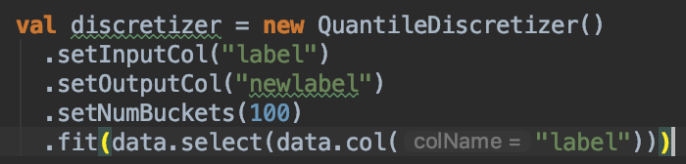
Multi-Layer Perception Classifier cont.
If we want to convert the problem into a classification problem, we have to change the target variable into category variable.
We can find a series of buckets and map target value into those buckets with appropriate bucket size.
So we apply QuantileDiscetizer to transform continous variable to category variable when building pipline.

Slide 15
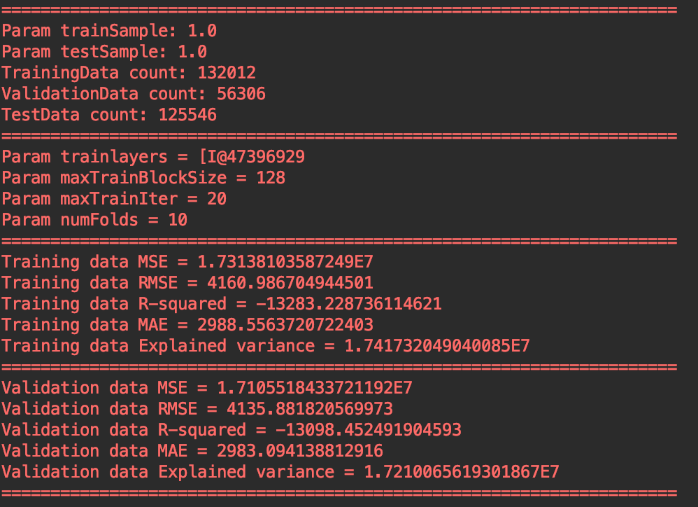
Multi-Layer Perception Classifier Result
Though we put 100 neurons in each hidden layer, we still achieve a bad result after training for a long time, maybe we should change bucket size or number of layers to do further testing.

Slide 16
"Gradient Boosting Tree" Intro
Gradient Boosting Tree(GBT) and Random Forest(RF) both are ensemble learning methods and predict (regression or classification) by combining the output from individual trees.
GBT build trees one at a time, where each new tree helps to correct errors made by previously trained tree.

Slide 17
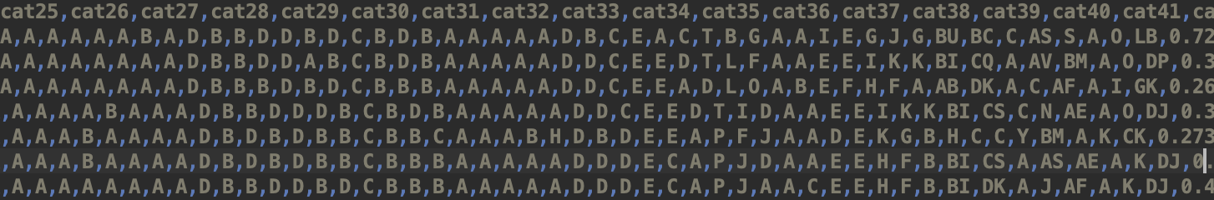
"Gradient Boosting Tree" Data Form
training dataset : dropp off the category with too many type

Slide 18
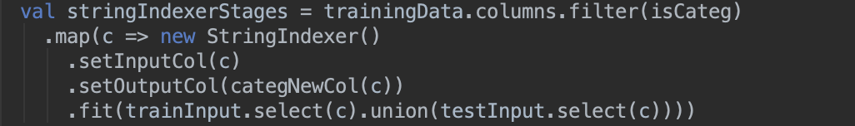
"Gradient Boosting Tree" Data Form
separate feature column & continuous column

Slide 19
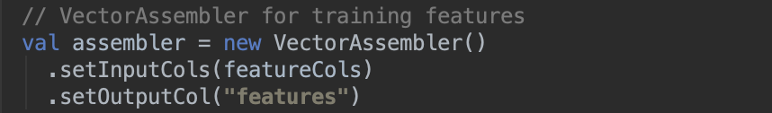
"Gradient Boosting Tree" Data Form
features column => vector (String Indexer)

Slide 20
"Gradient Boosting Tree" Pipeline
Estimator Algorithum:
Set up the pipeline:

Slide 21
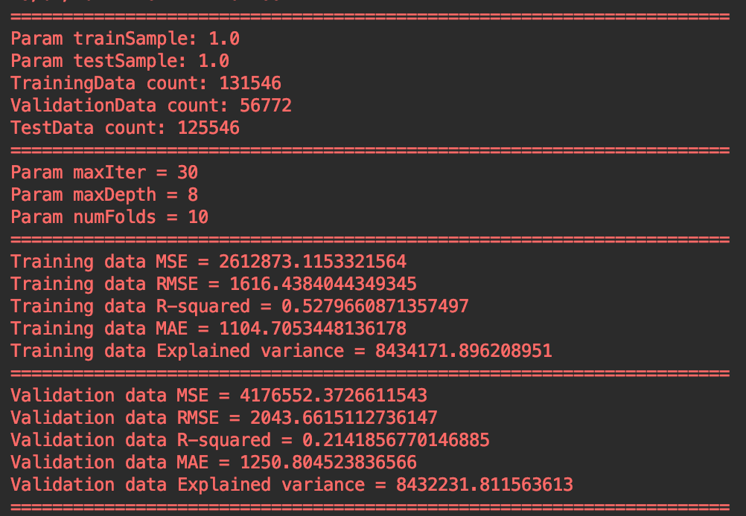
"Gradient Boosting Tree" Conclusion
MAE is 1250, it achieve better performance compared to the Random Forest. But in the real environment. It took much longer time to complete the training.

Slide 22
Conclusion
Current achievement:
We got a current best MAE of 1290 which is much closer to the goal of 1100. We may adjust the hyper-parameters to obtain better result.

Slide 23

Pre-Plan Acceptance Criteria
Reach a "Mean Absolute Error(MAE)" over 1100. (Measured by Kaggle)
Our system will also show the performance gap between the "random forest regression" and "gradient tree regression" models.

Slide 24
Thank you

